Slide 1
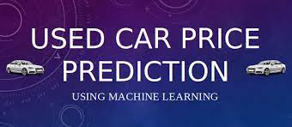
Used Car Price Prediction
Represented By : Raganee Verma

Slide 2
INTRODUCTION Due to the numerous elements that influence a used vehicle's market pricing, determining if the advertised price is accurate, is a difficult undertaking. The goal of this project is to create machine learning models that can properly forecast the price of a used car based on its attributes so that buyers can make educated decisions.
Analytical Problem Framing
Mathematical/ Analytical Modelling of the Problem
The solution is divided into the following sections:
Data understanding and exploration
Data cleaning
Date Visualization
Data preparation
Model building and evaluation

Slide 3
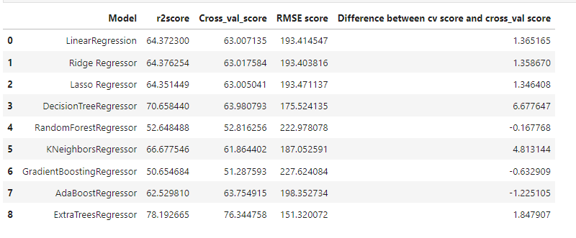
Data understanding and exploration I have scraped used cars data from CarDekho.com The Dataset contains 5980 rows and 8 columns. The column "Price” is the target variable and rest of the columns are independent variables.
Model_variant : A car's make is the brand of the vehicle, while the model refers to the name of a car product and sometimes a range of products.
Brand(Company name) : A type of product manufactured by a particular company under a particular name.
Year(Manufacture year): The Production market classifies years to specific vehicles, and model codes in place of the model year.
Diven_Kilometer : The car is driven for particular distance.
Fuel_Type : Types of fuel is used for particular car.
Transmission : the mechanism by which power is transmitted from an engine to the axle in a motor vehicle.
Sell_price : The car is quoted for particular price to sell it.
Location : A particular place or position where car is sold.

Slide 4
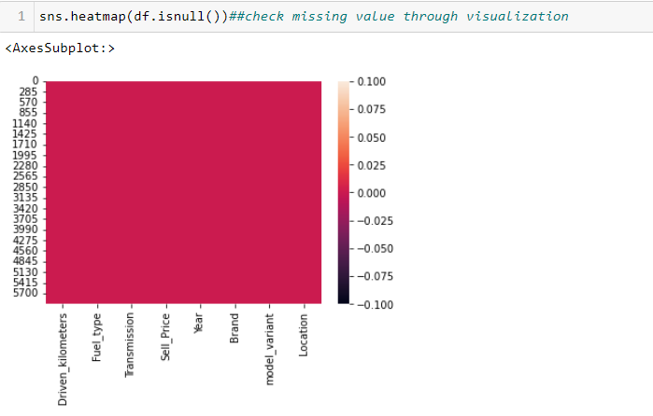
Data cleaning and feature engineering Data cleaning is the process of fixing or removing incorrect, corrupted, incorrectly formatted, duplicate, or incomplete data within a dataset
1.We’ve seen that there are no missing values in the dataset by heatmap visualization.
2. There are 44 duplicate value is present but no need to remove it because may be same car model is selling in same price.
3. Add new column car_age that is calculated by using current year minus manufacturing year of car.
4. In ous dataset the sell_price data haveing different different unit like lakh,Cr,and thousand. So we convert it into one unit thousand and then convert it into object to intiger type data.
5. Eliminate comma symbol from kilometer_driven and convert it into integer type .

Slide 5
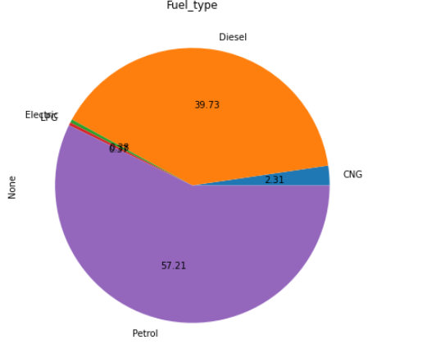
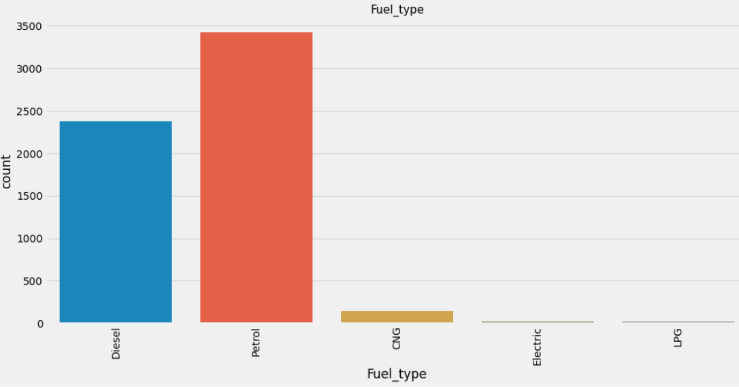
Data Visualization We are Analysing the data by various visualization technique Higher no. of petrol car (57%) is there and very few cars is LPG(0.35%) fuel type

Slide 6
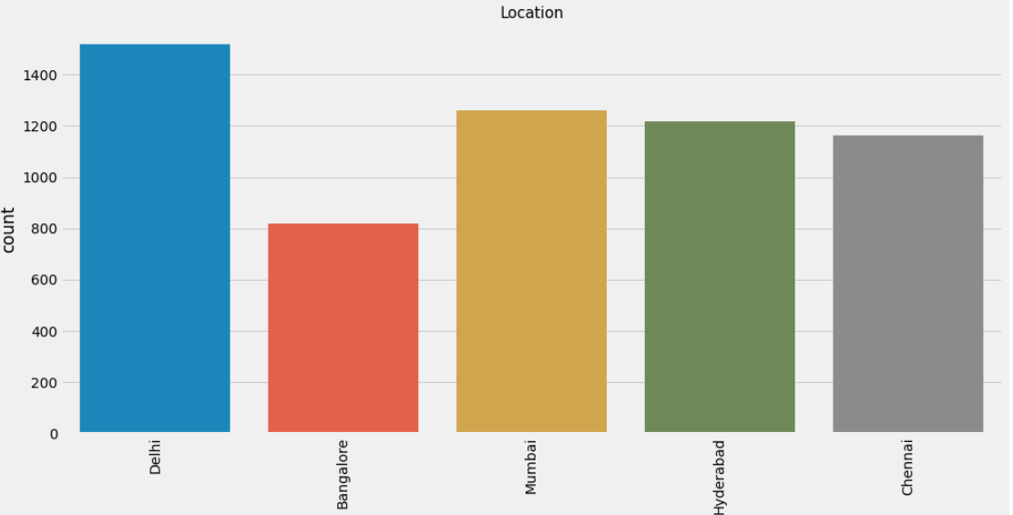
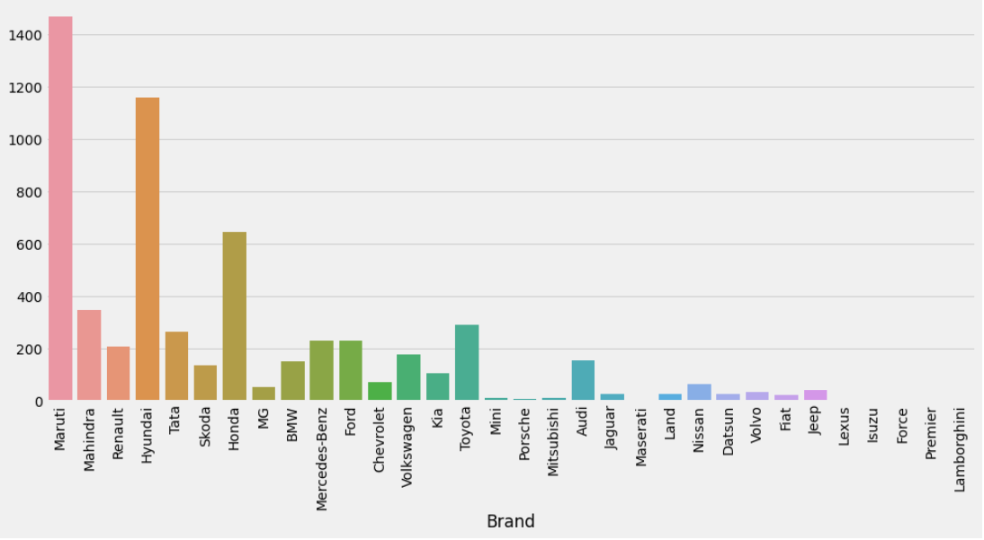
Count Plot for brand and location Higher no. of used car is from Delhi. Maximum used car is Maruti and Huandai brand.

Slide 7
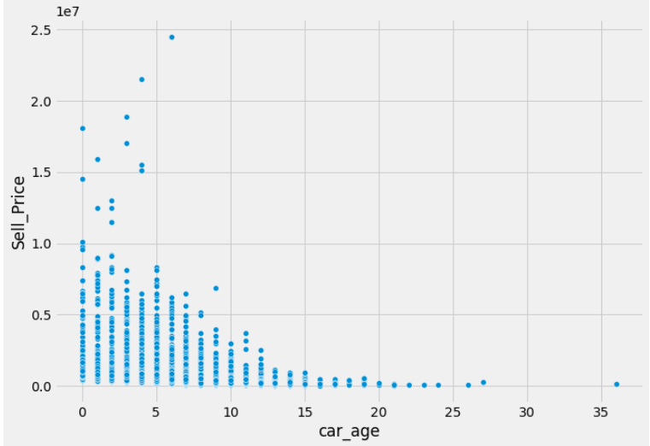
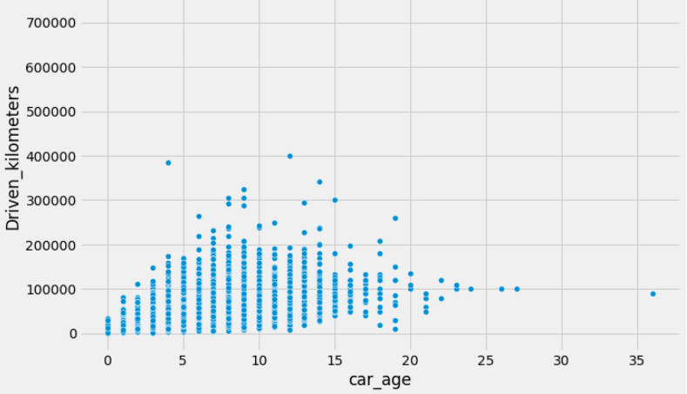
Bivariate Analysis Used car Price between zero to 7 year is good. The value of used car depreciates as soon as exceeds 10 years when the age of car increased kilometer driven is also increased.

Slide 8
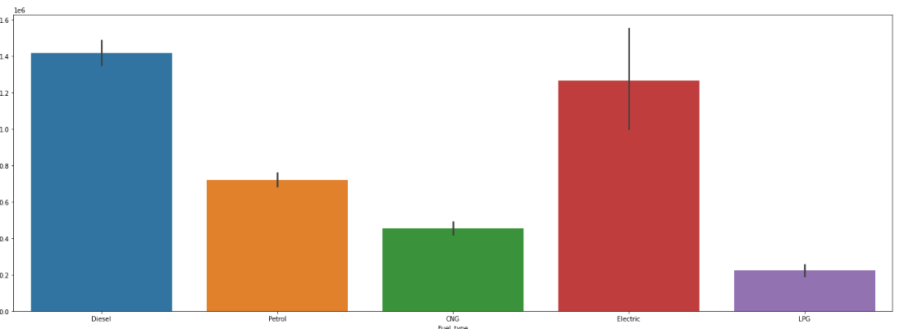
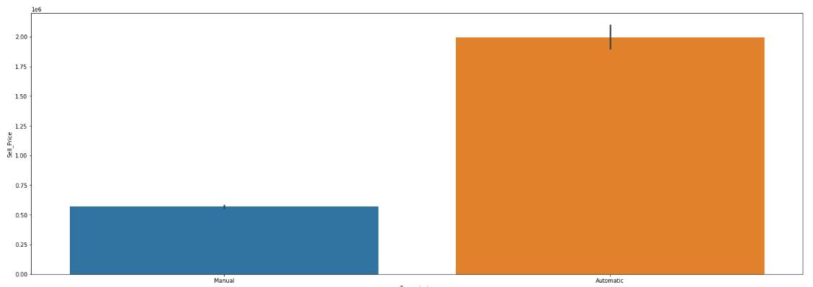
Analysis of categorical variable with target variable 1.The price of Diesel and electric car is higher approx. 5 to 25 lakhs. 2.The price of an automatic car is almost double that of a manual car and the price maximum no. of used automatic cars lies betweem 10 to 30 lakh

Slide 9
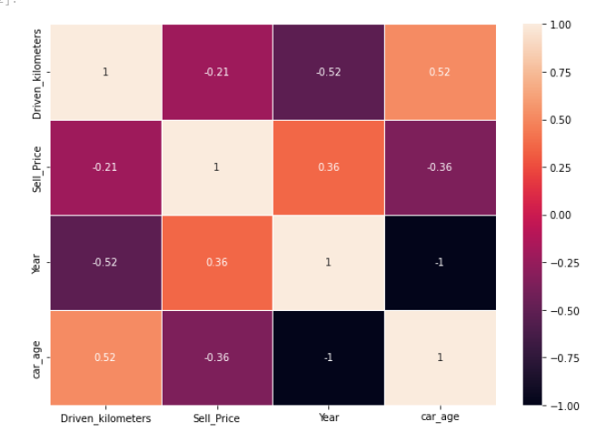
Correlation
It is time to check for relationships among attributes. A correlation matrix was used to determine whether relationships exist
Both Driven_Kilometers and car_age is negative correlated with the target variable (car selling price) means the car which is older and driven higher is greater selling price.

Slide 10
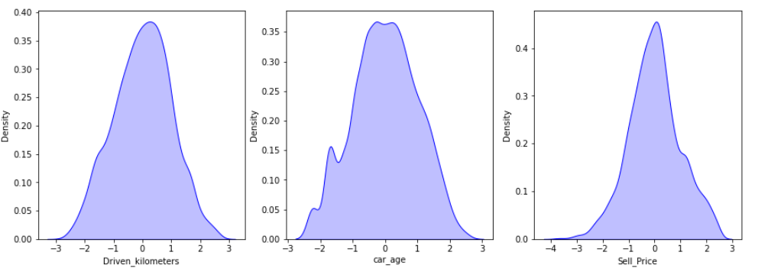
Data preparation
I have done following steps for our data is to be clean:
Drop unnecessary column.
Remove outliers using z-score
Remove skewness by using log
Transform technique.
Scaling our data by using standardisable

Slide 11
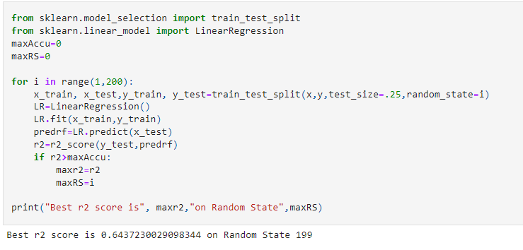
Model building since our target feature cell_price is an numerical value this became Regression problem.
Steps for machine learning model building:
Train Test Split
Finding Best Random State
Testing various Regression models
Compare All Model Performance
Hyperparameter tuning of best model
Model building and best line for Selected model
Saving, Loading and Conclusion the best Classification ML model

Slide 12
Testing various Regression models
8 Type of Regression Algorithm which are used for model building
Compare all model performance
Linear Regression
Ridge Regression
Lasso Regression
Decision Tree Regression
K neighbour Regression
Random Forest Regression
AdaBoost Regression
Gradient Booster Regression

Slide 13
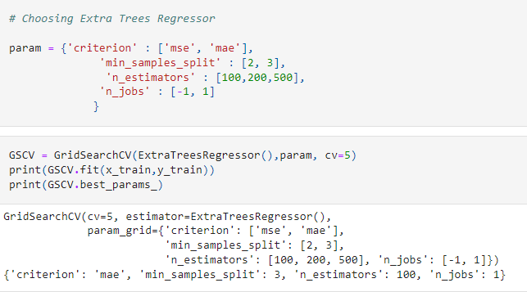
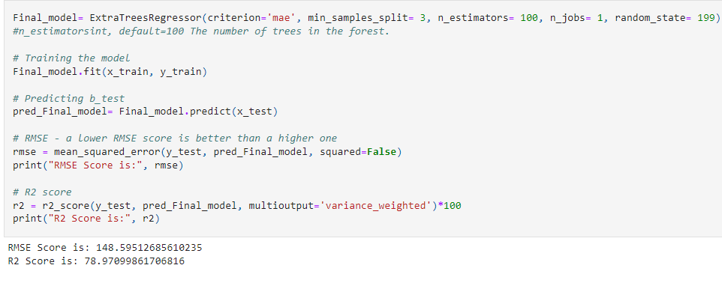
Extra Tree Regresser is our best model ExtraTreesRegressor is our best model and difference between CV and R2 score is minimum for this particular model
Hyperparameter tuning of best model
Model building and best line for Selected model

Slide 14
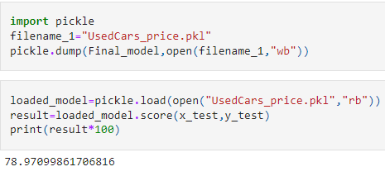
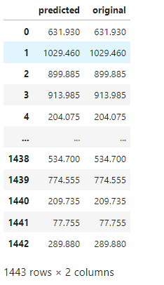
Saving, Loading and Prediction the best Regression ML model

Slide 15
Conclusion
Car price prediction can be a challenging task due to the high number of attributes that should be considered for the accurate prediction. The major step in the prediction process is collection and pre-processing of the data. In this project various methods of python were built to normalize, standardize and clean data to avoid unnecessary noise for machine learning algorithms.
Data cleaning is one of the processes that increases prediction performance, yet insufficient for the cases of complex data sets as the one in this research. Applying single machine algorithm on the data set accuracy was less than 60%. Therefore, the ensemble of multiple machine learning algorithms has been proposed and then the ExtaTree Regression ML methods gains accuracy of 78%. This is significant improvement compared to single machine learning method approach. However, the drawback of the proposed system is that it consumes much more computational resources than single machine learning algorithm. Although, this system has achieved astonishing performance in used car price prediction problem our aim for the future research is to test this system to work successfully with various data sets. We will extend our data with Car Dekho used cars data sets and validate the proposed approach.

